Slide 1


AI Powered Data Analysis Remote Internship
TEAM - 8
Israel
Vatsal
Riyanshi
Bridgitte
Preta
Kashish
Angela
irakli

Slide 2
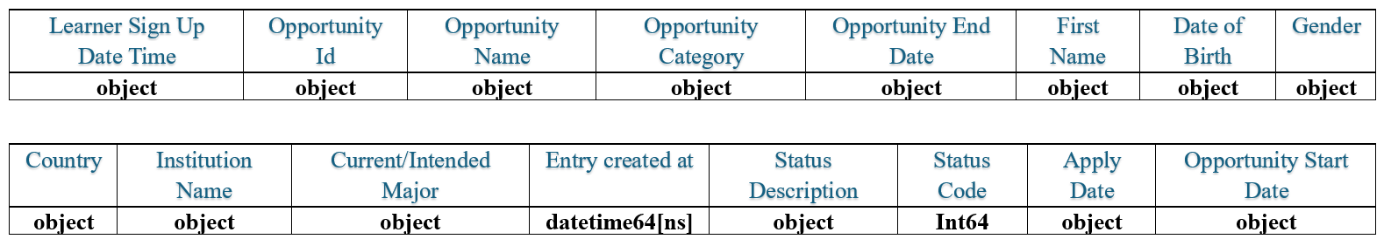
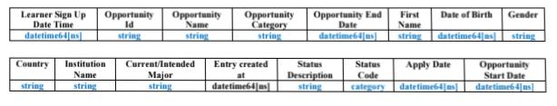


Dataset Overview
The given dataset consists of 16 columns (features), and 8558 entries and the features names and types as follows:
That is changed data type:
Tools used

Slide 3
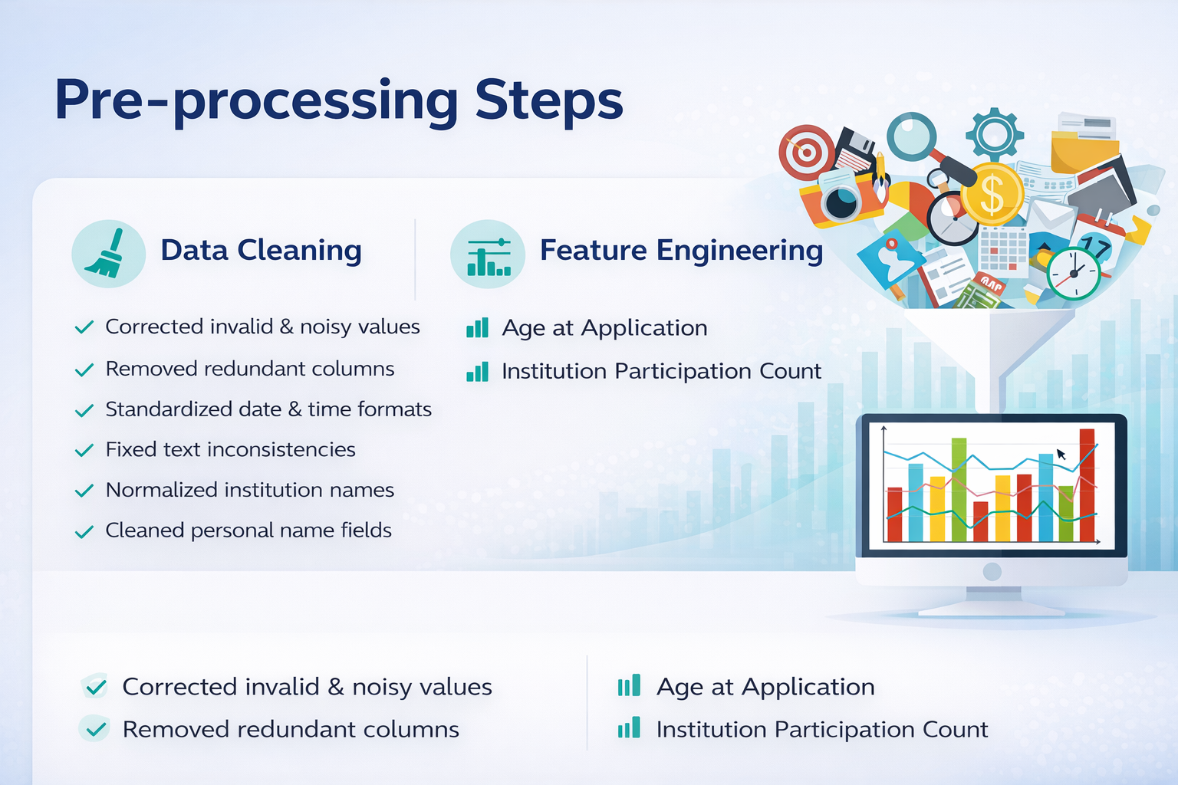


Slide 4
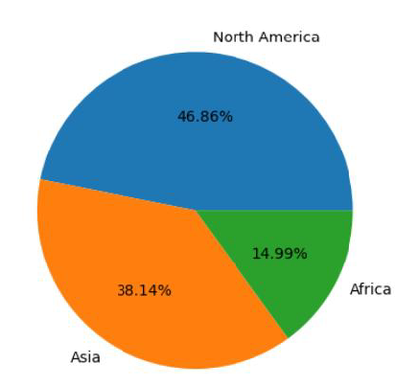
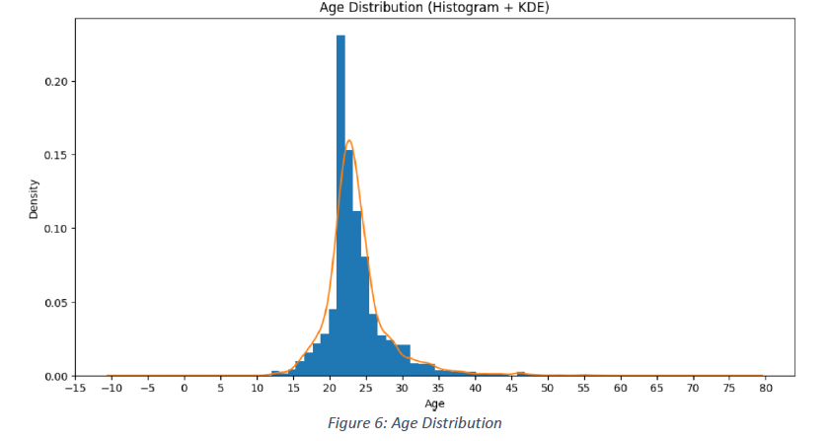
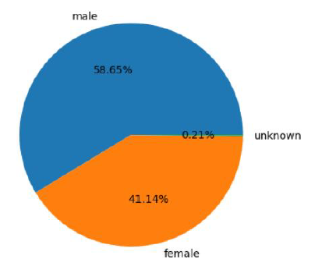
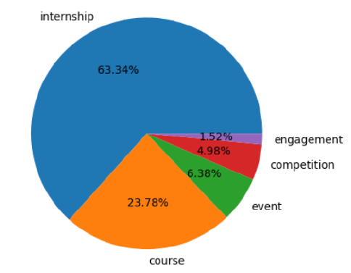
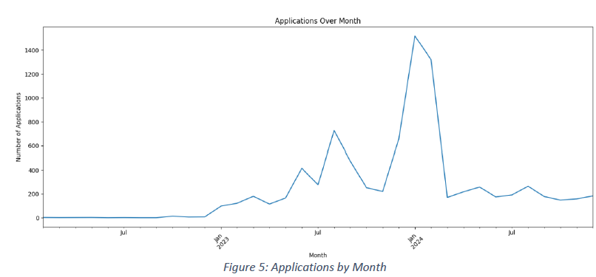
Exploratory Data Analysis
Key Visual Analysis
Learners by continent and opportunity category
Gender and age distribution
Year-wise and month-wise application trends
Major Insights
North America shows highest participation
Internships are most popular opportunity
Majority of learners completed programs
Strong growth in applications (2023–2024)
Most active learners aged 18–25

Slide 5

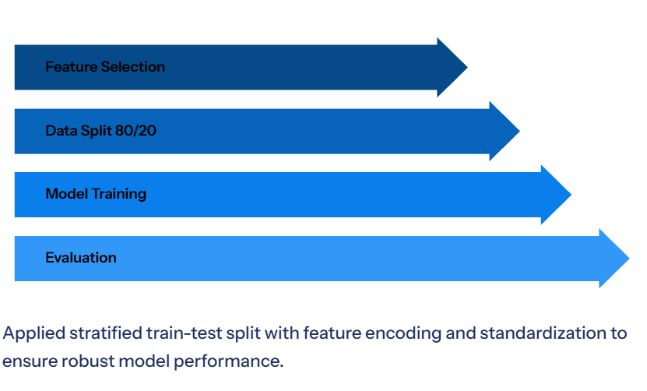
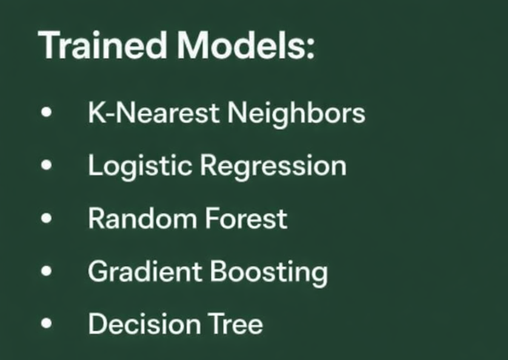
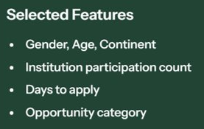
Model Building
Link

Slide 6
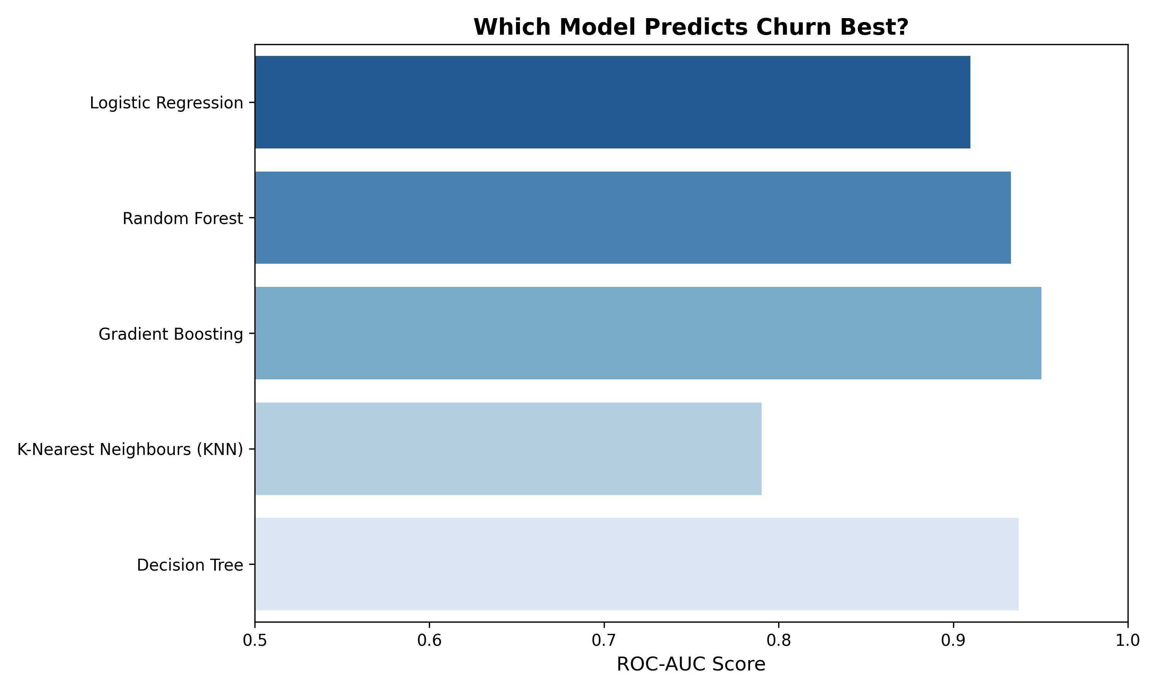
Model Evaluation
Five classification models were trained and evaluated for learner churn prediction. Their performance was compared using accuracy score.
Model | ROC-AUC
Logistic Regression | 0.909790257
Random Forest | 0.932935806
Gradient Boosting | 0.950439716
K-Nearest Neighbours (KNN) | 0.790135781
Decision Tree | 0.937441527
Key Findings
Gradient Boosting delivered the most reliable and consistent performance among all models.
Effectively captured non-linear relationships and feature interactions influencing churn.
Showed stronger ability to identify churn patterns compared to other algorithms.
Random Forest and Decision Tree achieved competitive performance but were less consistent than Gradient Boosting.
KNN performed very less effective in detecting complex churn behavior compared to other models.

Slide 7

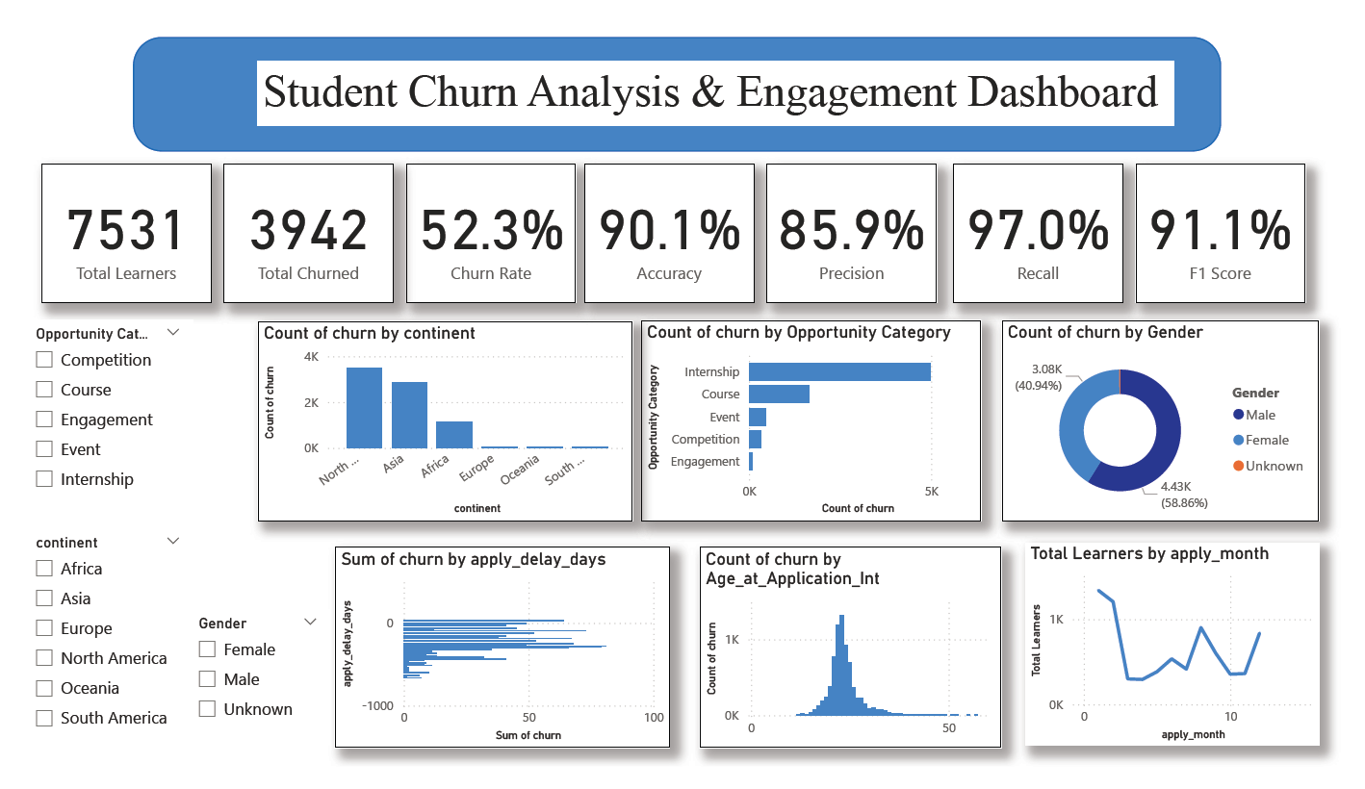

Slide 8
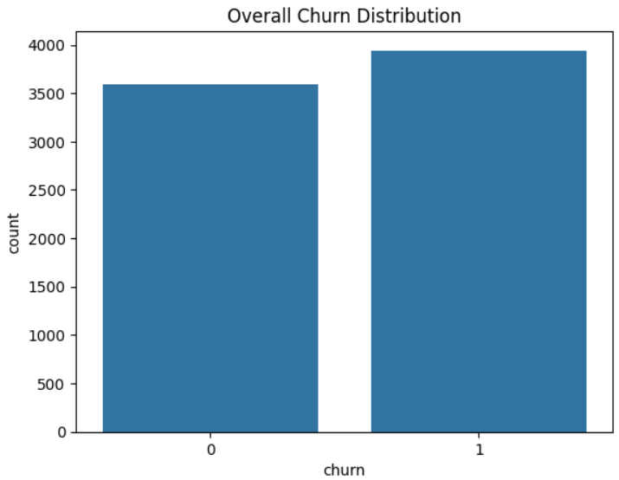
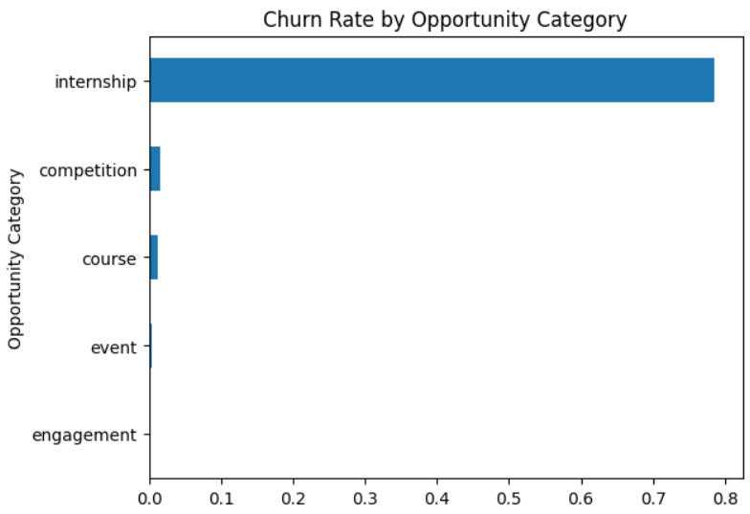
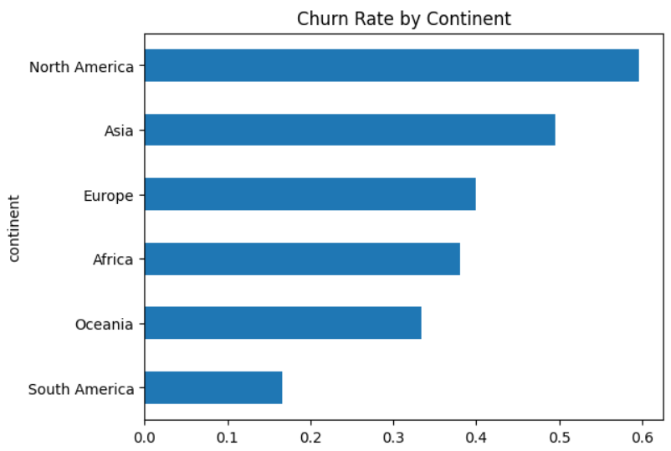
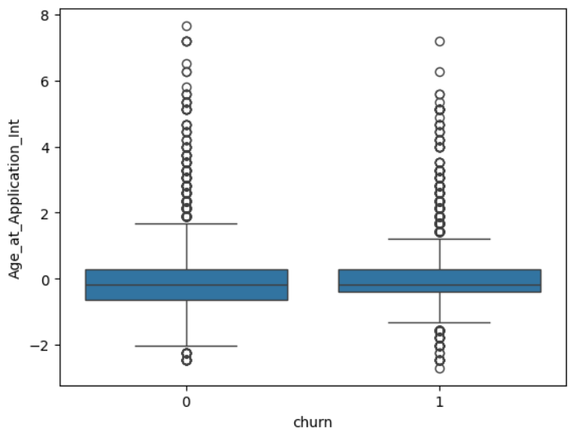
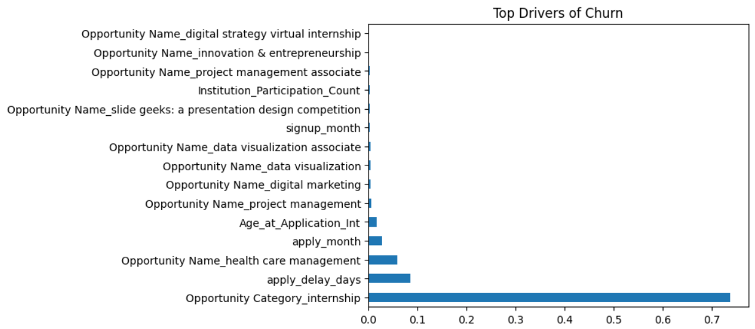
Key Factors Affecting Churn
Internships show the highest churn compared to courses and competitions, suggesting expectation mismatch or higher commitment barriers.
We observe that churn is slightly higher than retention, indicating a persistent dropout issue across the platform.
Churn is highest in North America and Asia, while South America shows stronger retention trends.
Age shows moderate influence, but it is not a dominant standalone churn driver.
Overall, churn is mainly driven by opportunity type, apply delay days, application , geography, and engagement level rather than demographic variables alone.

Slide 9

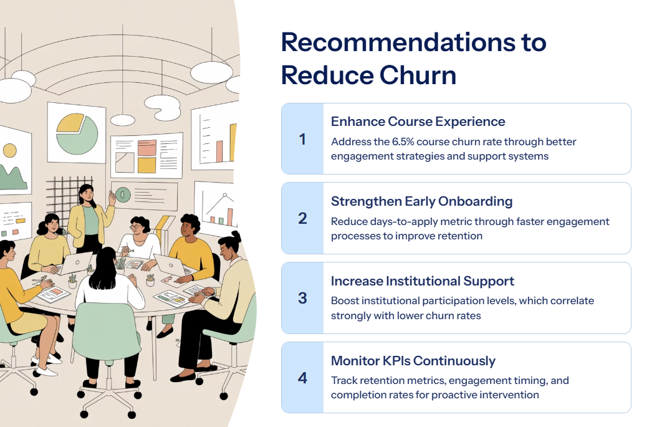
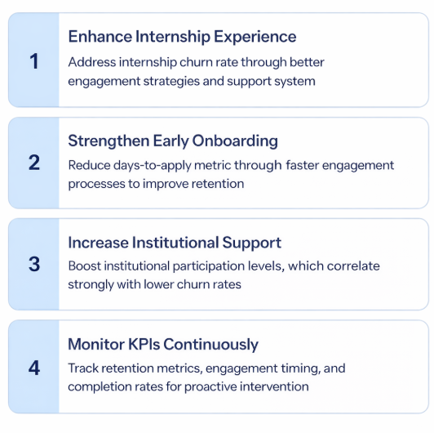
Recommendations for reduce churn

Slide 10
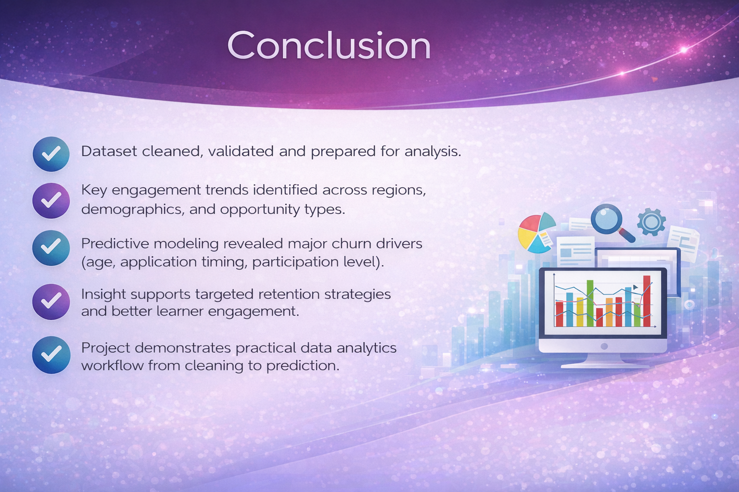
Conclusion
Dataset cleaned, validated and prepared for analysis.
Key engagement trends identified across regions, demographics, and opportunity types.
Predictive modeling revealed major churn drivers (age, application timing, participation level.
Insight supports targeted retention strategies and better learner engagement.
Project demonstrates practical data analytics workflow from cleaning to prediction.

Slide 11
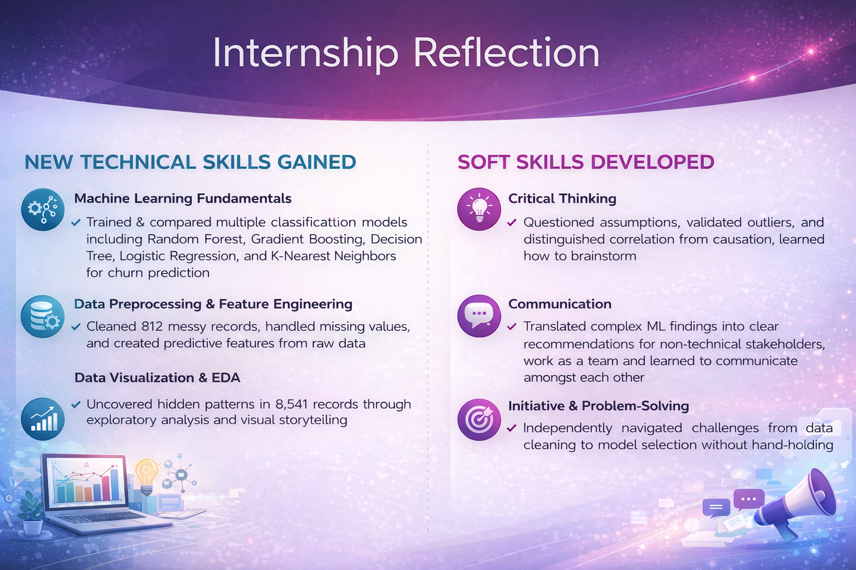
Internship Reflection

Slide 12
Reference Links
Link for the Presentation video
Week 01: Analyse the Data
Week 02: EDA on the Data
Week 03: Model Trainning

Slide 13


